Slide 1




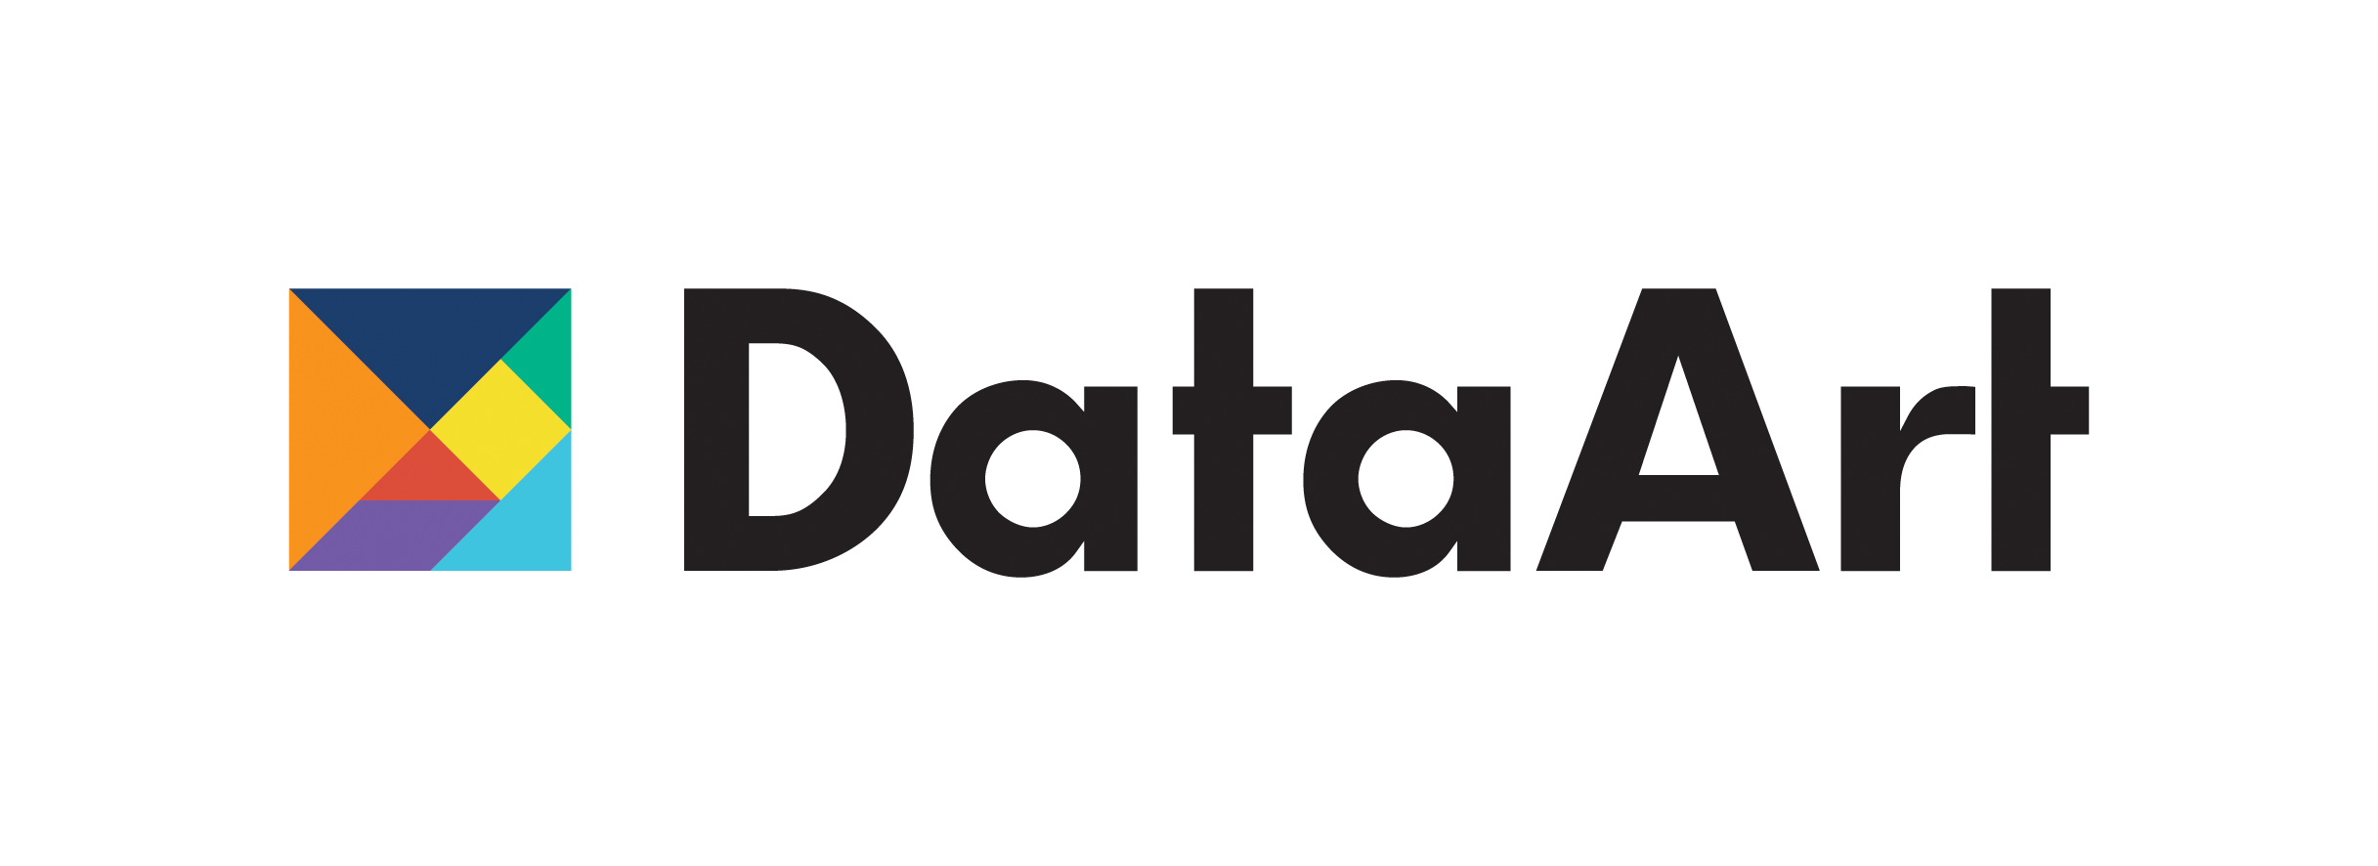
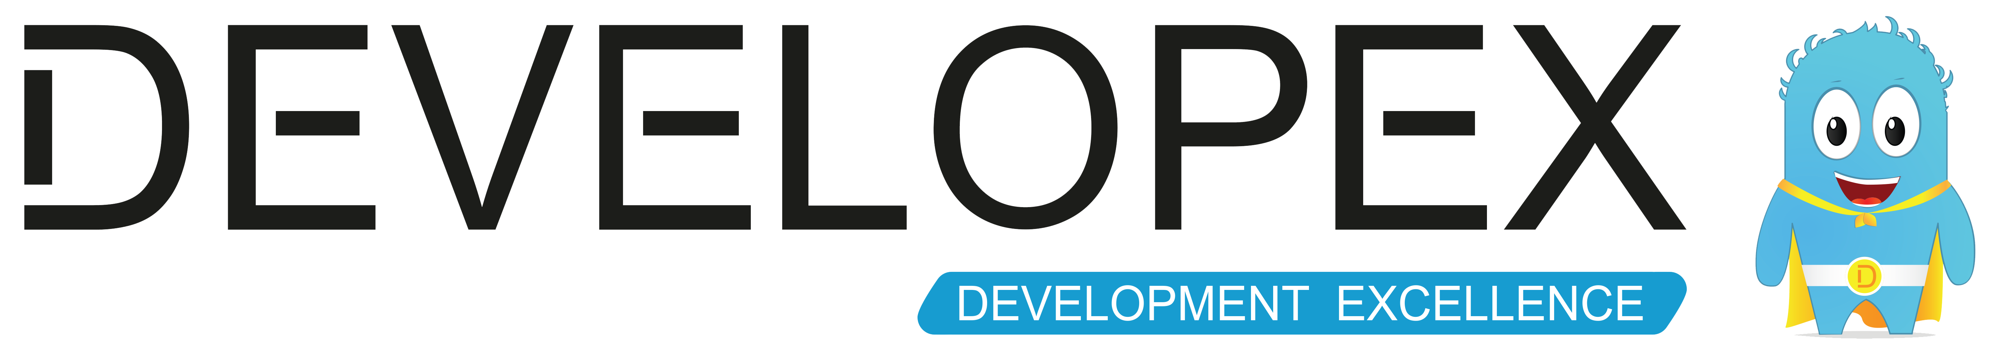

Slide 2
Lets talk about DDD
Bezpalyi Kyrylo
Ciklum, MSP.

Slide 3
What is DDD?
It is a way of thinking and a set of priorities, aimed at accelerating software projects that have to deal with complicated domains.
A Model driven software design approach used to tackle the complexity of software projects.
Collection of principles and patterns that help developers craft elegant systems.

Slide 4
Definitions
Domain A sphere of knowledge or activity. What an organization does and the world it does it in.
Model A system of abstractions that describes selected aspects of a domain and ignores extraneous detail. Explains a complex domain in a simple way.
A model is a distilled form of domain knowledge, assumptions, rules and choices.

Slide 5
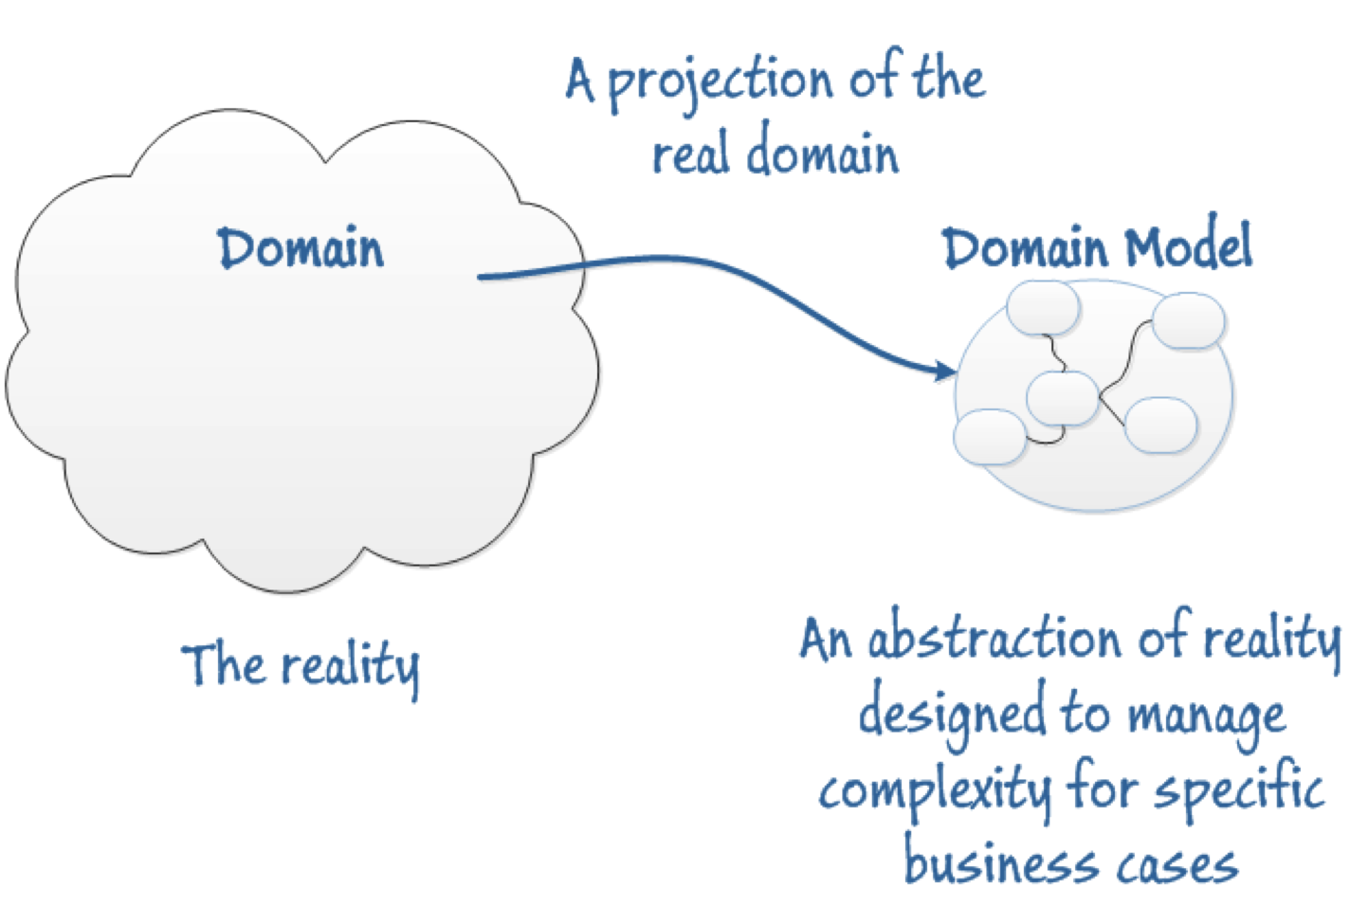
Notes:
5

Slide 6
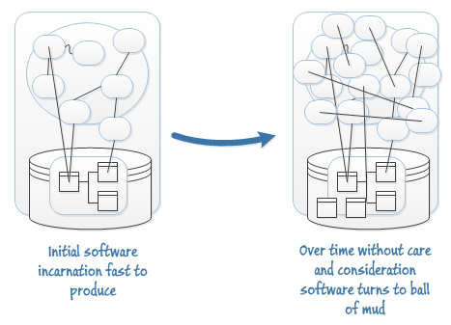
Notes:
6

Slide 7
DDD is a Set of Driving Principles
Speak a Ubiquitous Language within an explicitly Bounded Context.
Explore models in a creative collaboration of domain practitioners and software practitioners.
Focus on the Core Domain.
Model and implementation are bound... developers are also responsible for the model.
Notes:
7
7

Slide 8
Ubiquitous Language
Ubiquitous Language A language structured around the domain model and used by all team members to connect all the activities of the team with the software.
Use it consistently in speech, documentation, diagrams and code.
A Change in Ubiquitous Language <=> Change in Model and Code.
Notes:
8
8

Slide 9
The model we want…
Helps us solve specific problems in our domain.
Is not necessarily “realistic”.
Forms the basis of a language.
Should remain current.
Notes:
9

Slide 10
DDD is Agile and Iterative
The problem with Big Design Up Front:
Models are distilled knowledge.
At the beginning of a project, the team is as ignorant as it will ever be.
Up Front Analysis Locks in Ignorance!
Notes:
10
That is a pretty dense statement. Over the next few hours, we’ll try to define enough terms and explain enough of what we concretely do in order to unpack this statement.
10

Slide 11
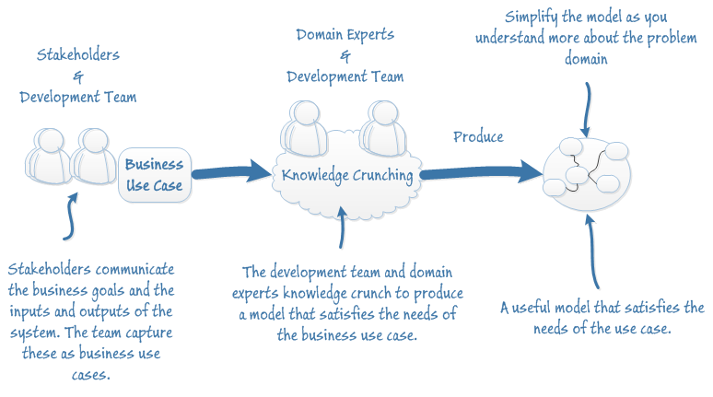
The DDD Process
Notes:
11

Slide 12
Breaking Down a Complex Domain
Bounded Context An operational definition of where a particular model is well-defined and applicable. (Typically a subsystem, or the work owned by a particular team).
Subdomain Part of the domain, based on a particular conceptual decomposition of the domain.
Notes:
12

Slide 13
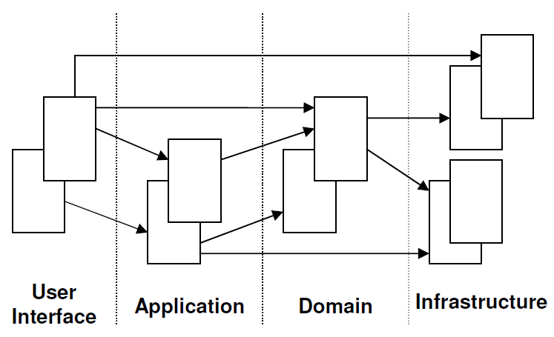
Layered Architecture
Notes:
13

Slide 14
Layers
User Interface Responsible for presenting information to the user and interpreting user commands.
Application This is a thin layer which coordinates the application activity. It does not contain business logic. It does not hold the state of the business objects.
Domain This layer contains information about the domain. This is the heart of the business software. The state of business objects is held here. Persistence details delegated to the Infrastructure layer.
Infrastructure This layer acts as a supporting library for all the other Layers. It provides communication between layers, implements persistence for business objects, contains supporting libraries for the user interface layer, etc.
Notes:
14

Slide 15
Model Expressed in Software
Entities
Value Objects
Aggregates
Services
Associations
Factories
Repositories
Modules
Context Mapping
Notes:
15

Slide 16
Entities
Objects which have an identity which remains the same throughout the states of the software.
Must be distinguished from other similar objects having the same attributes. (e.g. Bank Account for Jim Smith)
Attributes of an entity can change. (Mutable)
Entities should have behavior. (Business Logic)
No persistence behavior!
Notes:
16

Slide 17
Value Objects
Value Objects are the “things” within your model that have no uniqueness.
They are only equal to another Value Object if all their attributes match.
Value Objects are interchangeable.
Attributes of a Value Object cannot change, they must be replaced. (Immutable)
Examples: Money, Address (usually), DTO
Notes:
17

Slide 18
Aggregates
An Aggregate is a cluster of Entities and Value objects. (Object Graph) Each aggregate is treated as one single unit.
Each Aggregate has one root entity know as the Aggregate Root.
The root identity is global, the identities of entities inside are local.
External objects may have references only to root.
Internal objects cannot be changed outside the Aggregate.
Notes:
18

Slide 19
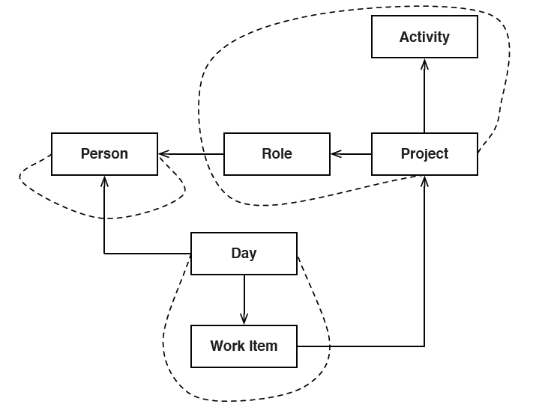
Aggregates
Notes:
19

Slide 20
Associations
Impose a traversal direction.
Add a qualifier, reduce multiplicity.
Eliminate non essential associations.
Notes:
20

Slide 21
Services Reside in Multiple Layers
Application “if the banking application can convert and export our transactions into a spreadsheet file... that export is an APPLICATION SERVICE”
Domain “If a service were devised to make appropriate debits and credits for a found transfer, that capability would be a DOMAIN SERVICE”
Infrastructure “a bank might have an application that sends an e-mail. The interface that encapsulates the email system is an INFRASTRUCTURE SERVICE”
Notes:
21

Slide 22
Domain Services
A Domain Service is Business Logic in the domain that are not a natural part of an Entity or Value Object.
Services usually manipulate multiple Entities and Value Objects.
Services are stateless!
A service has to be offered as an interface that is defined as a part of the model. Its parameters and results should be domain objects.
Notes:
22

Slide 23
Factories
An object whose responsibility is the creation of other objects.
Create and manage complex domain objects.
Especially useful for creating aggregates.
Notes:
23

Slide 24
Repositories
A Repository encapsulates domain objects persistence and retrieval.
Clean separation and one-way dependency between the domain and data mapping layers.
May encapsulate different fetching strategies, distributed caching, NoSQL, Web Service, etc.
Acts as a collection except with more elaborate querying capability.
One Repository per Aggregate!
Notes:
24

Slide 25
Modules
Break up your domain to reduce complexity
High cohesion within module, loose coupling between modules.
Becomes part of the ubiquitous language
Helps with decoupling
Aids in extensibility
Notes:
25

Slide 26
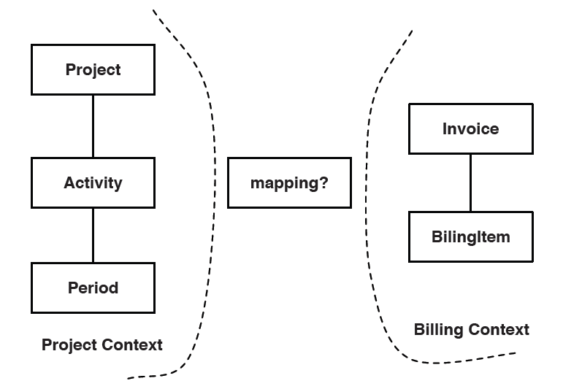
Context Mapping
Mapping the contact points and translations between bounded contexts.
Notes:
26

Slide 27
Patterns for Context Mapping
Shared Kernel
Customer/Supplier
Conformist
Anti-corruption Layer
Separate Ways
Notes:
27

Slide 28
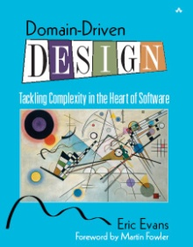
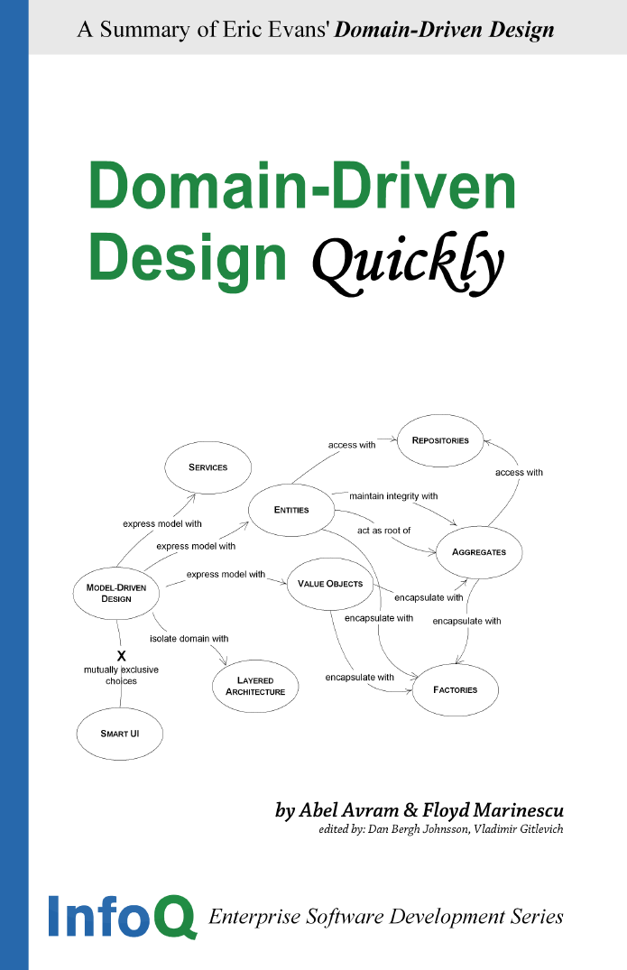
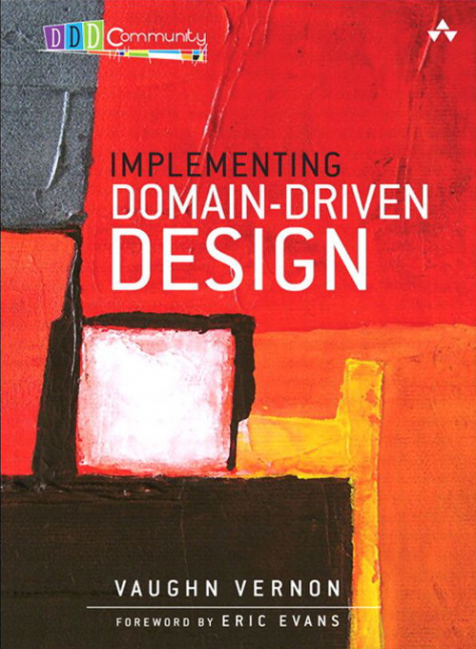
Resources
Notes:
28

Slide 29
These are not the same:
Subdomain – Decomposition of the domain.
Module – Decomposition of the model and associated software.
Aggregate – Decomposition of the run-time data.
Service – Decomposition of functionality.
Bounded Context – Linguistic boundary marking the applicability of distinct models.
Notes:
29

Slide 30
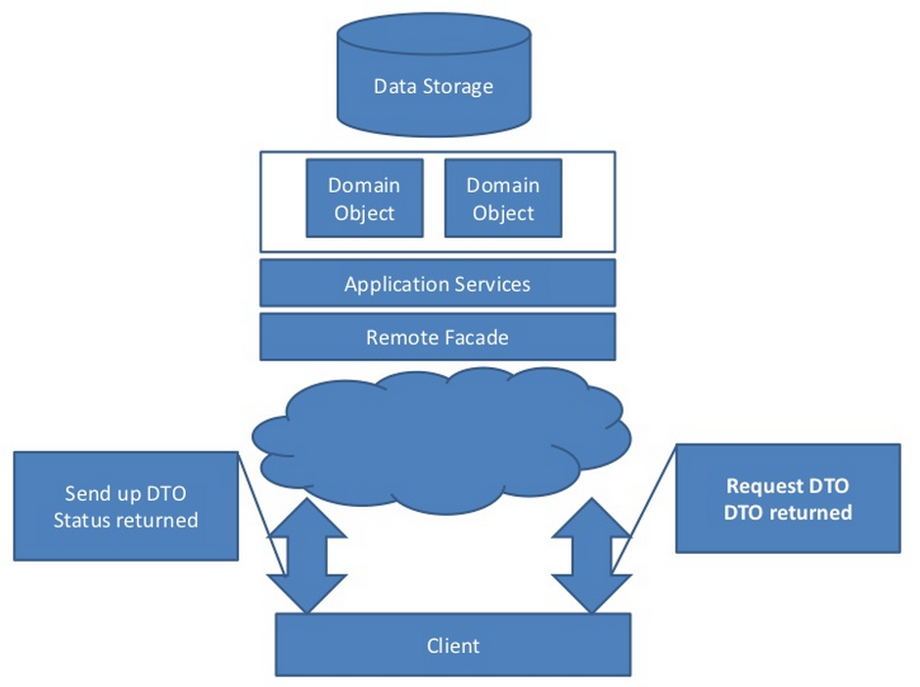
Command Query Responsibility Segregation (CQRS)
Notes:
30

Slide 31
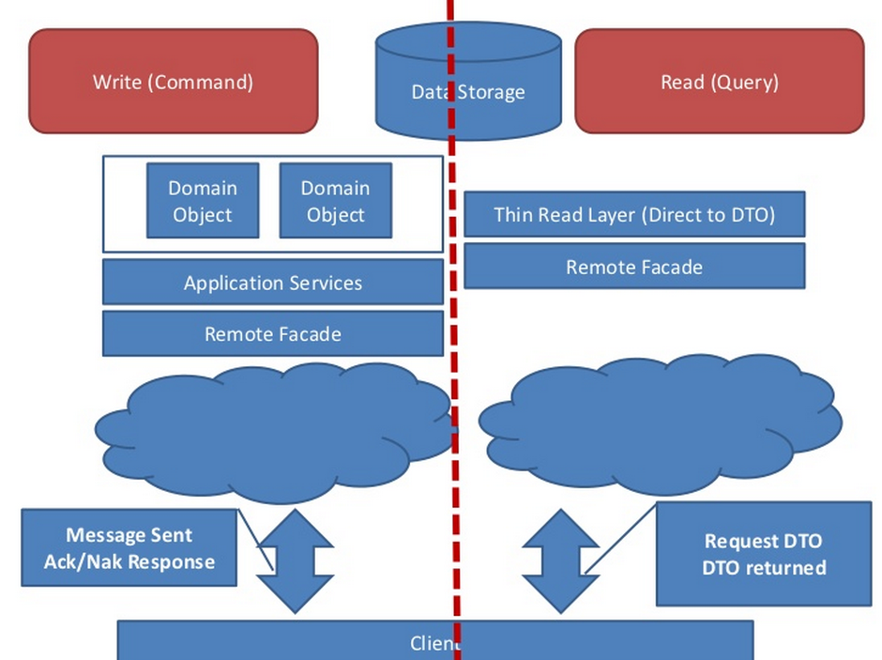
The data that a client needs from the model is screen based and different than the domain model.
Notes:
31

Slide 32
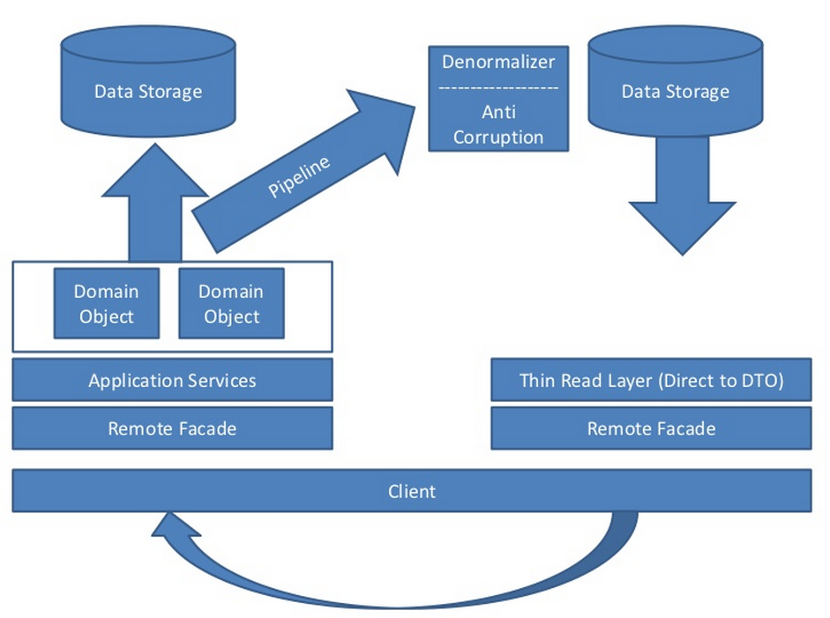
CQRS Implementation
Notes:
32

Slide 33
Questions?

